Slide 1
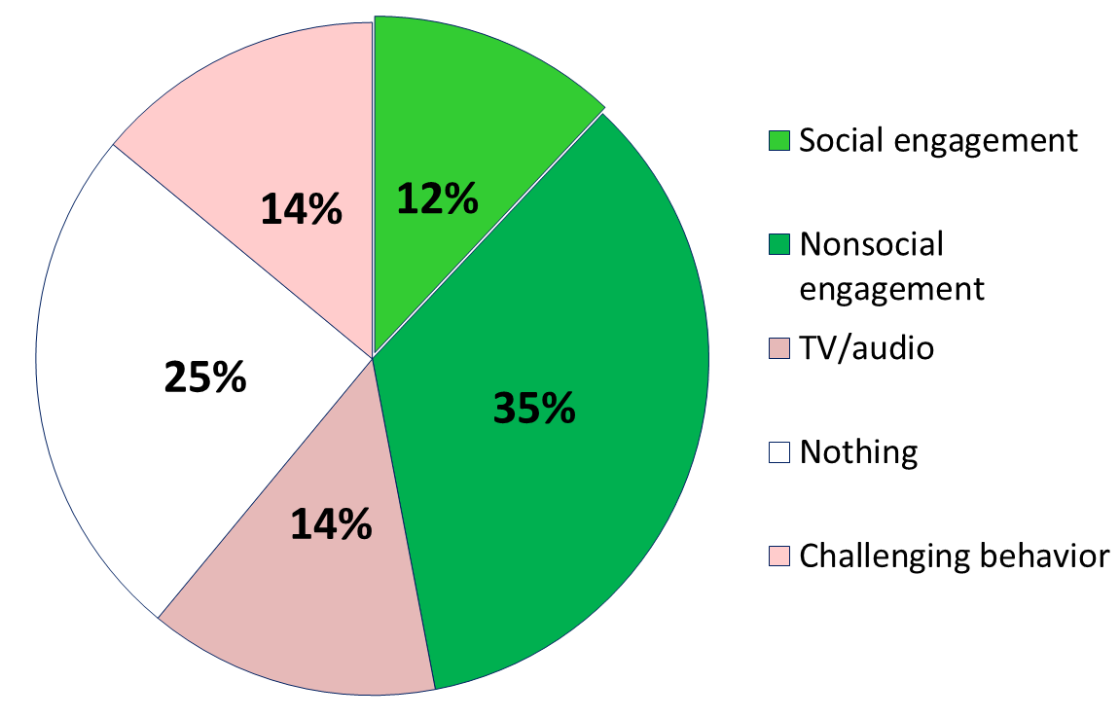
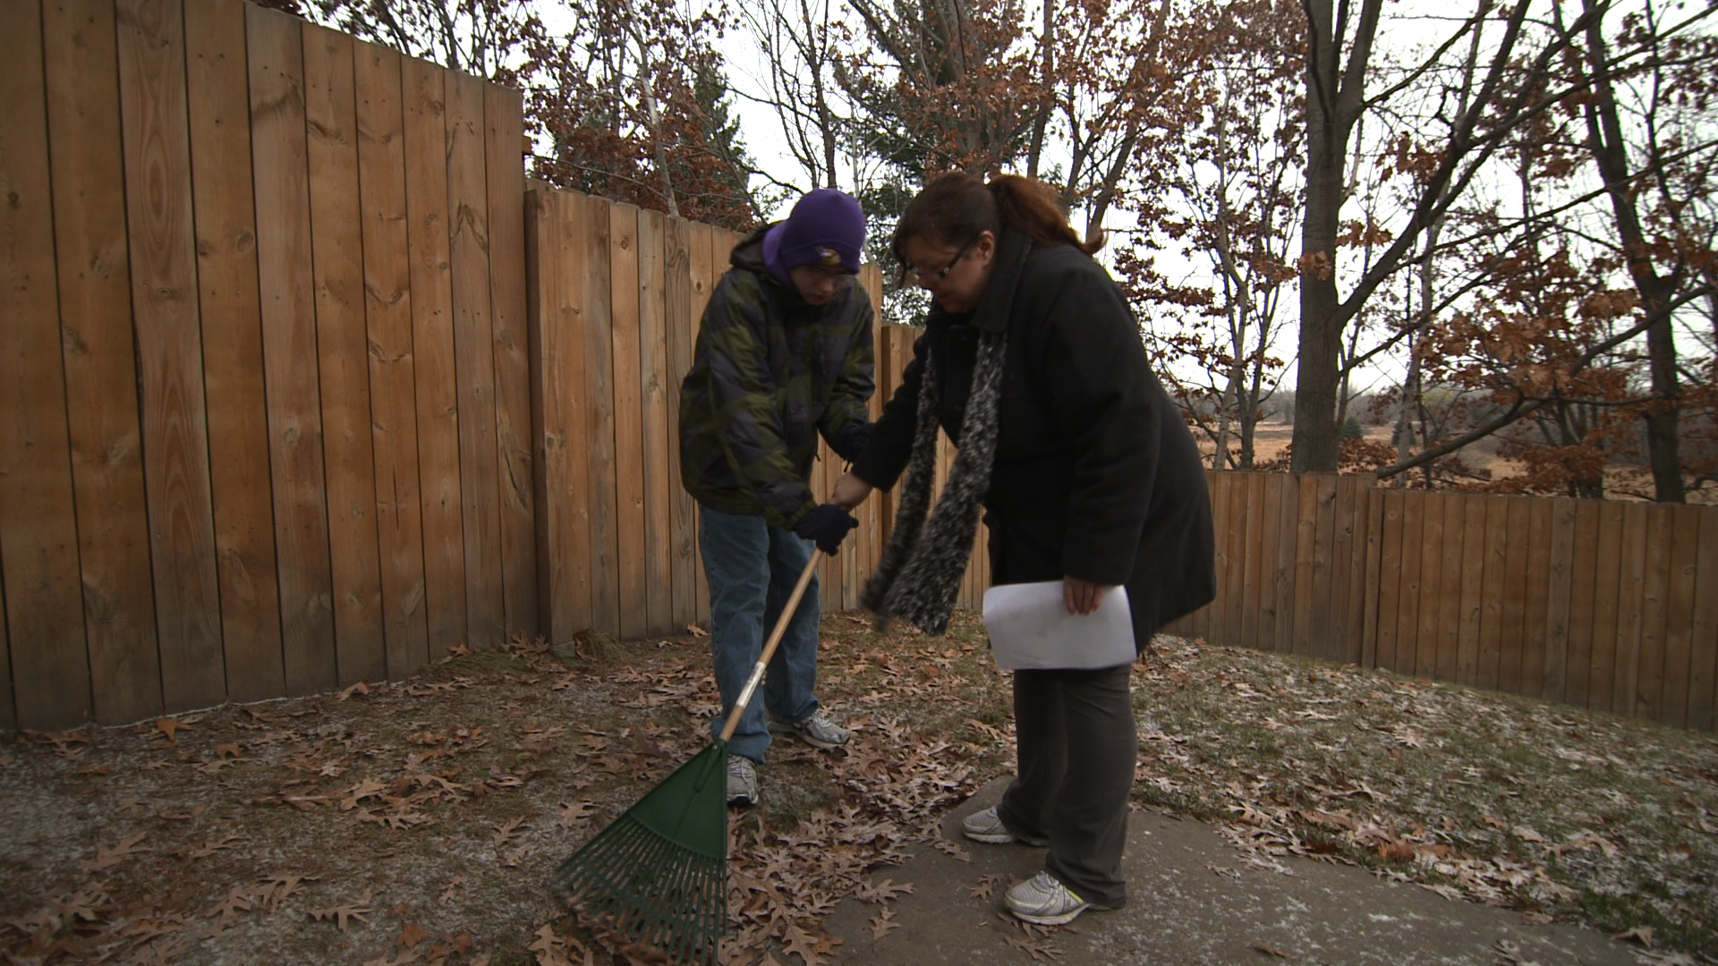
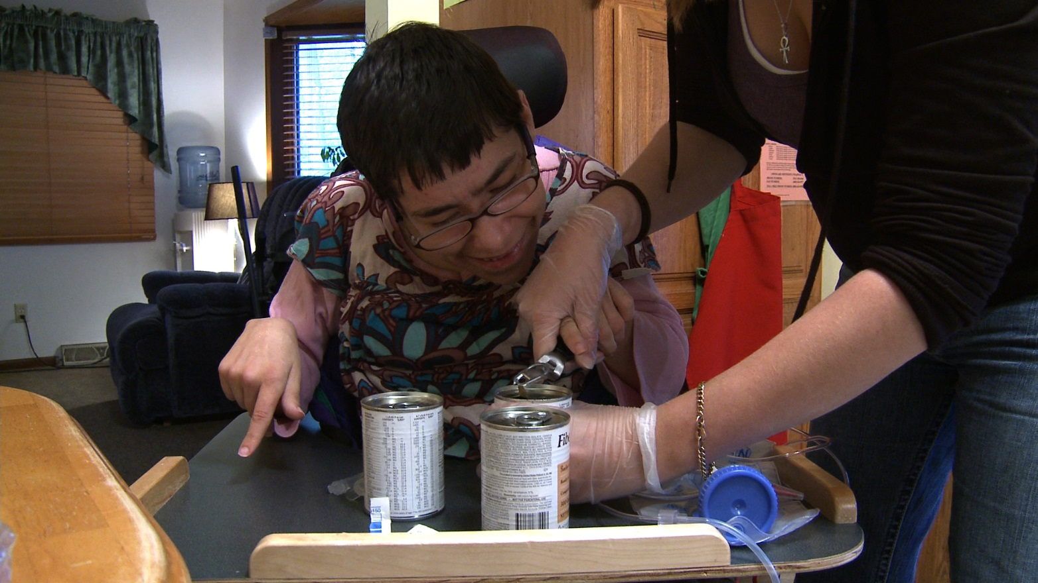
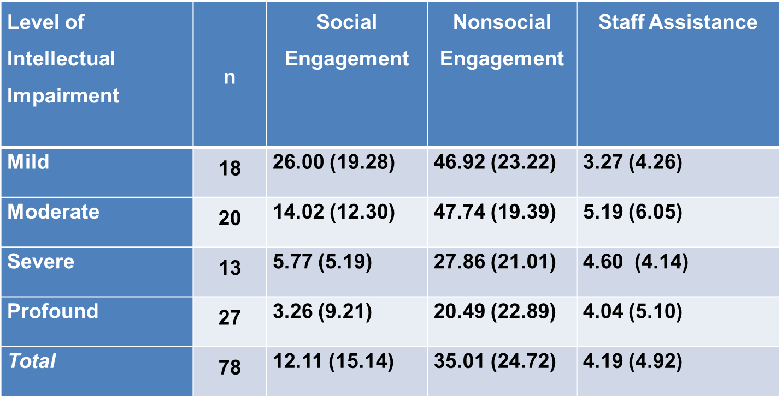
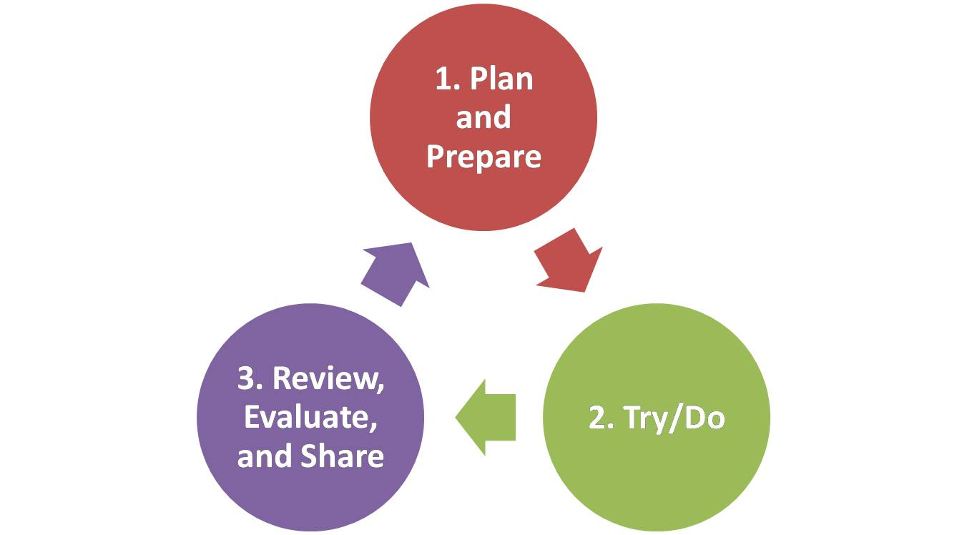
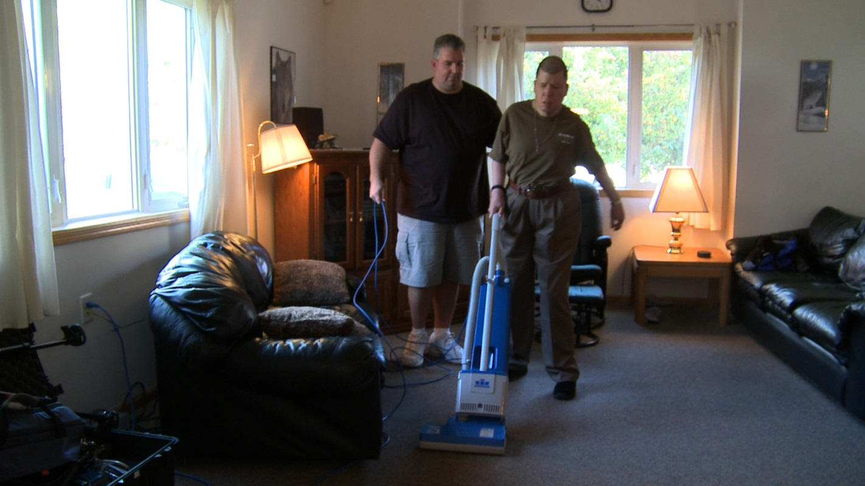
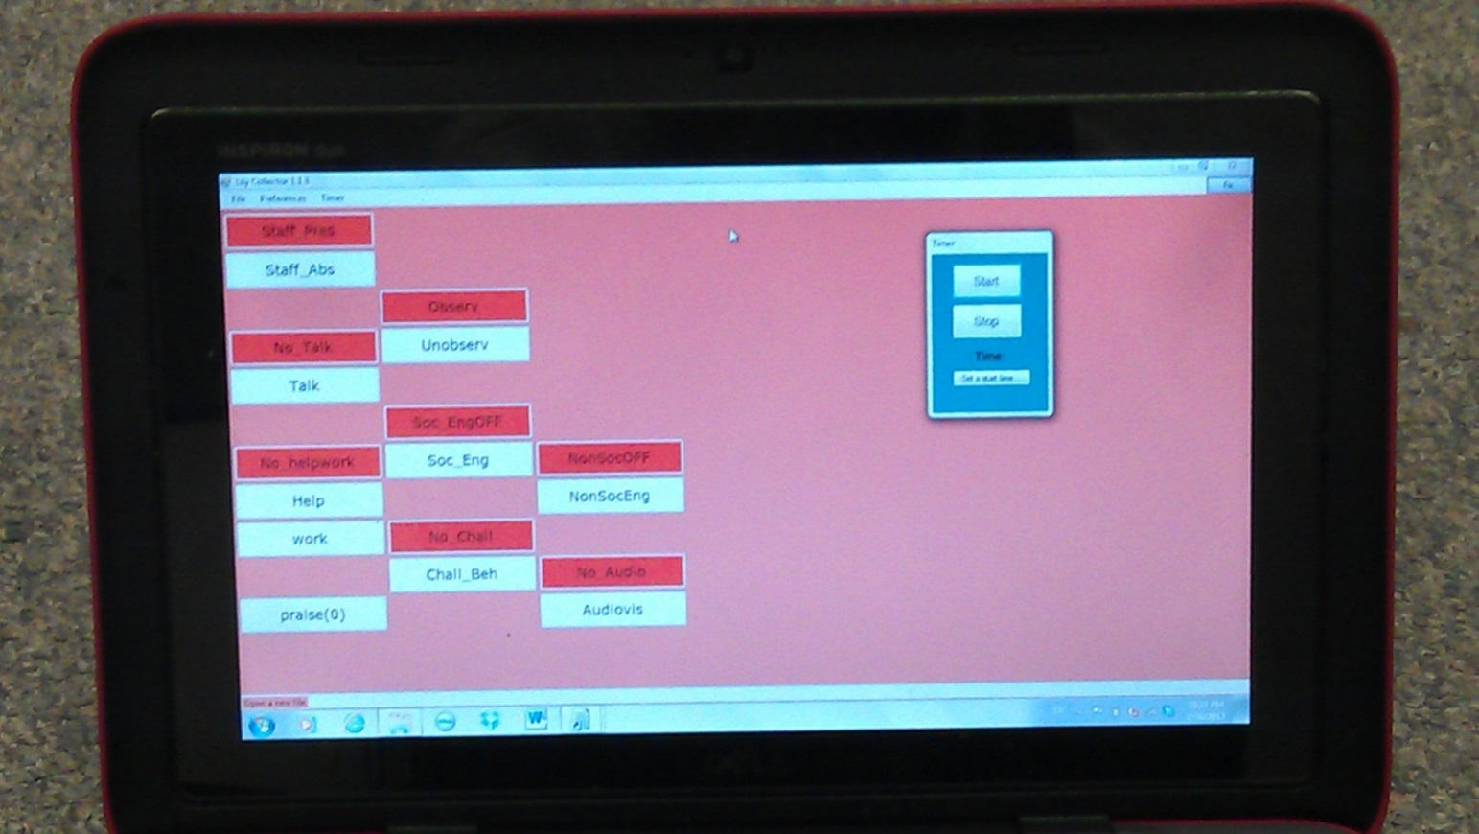
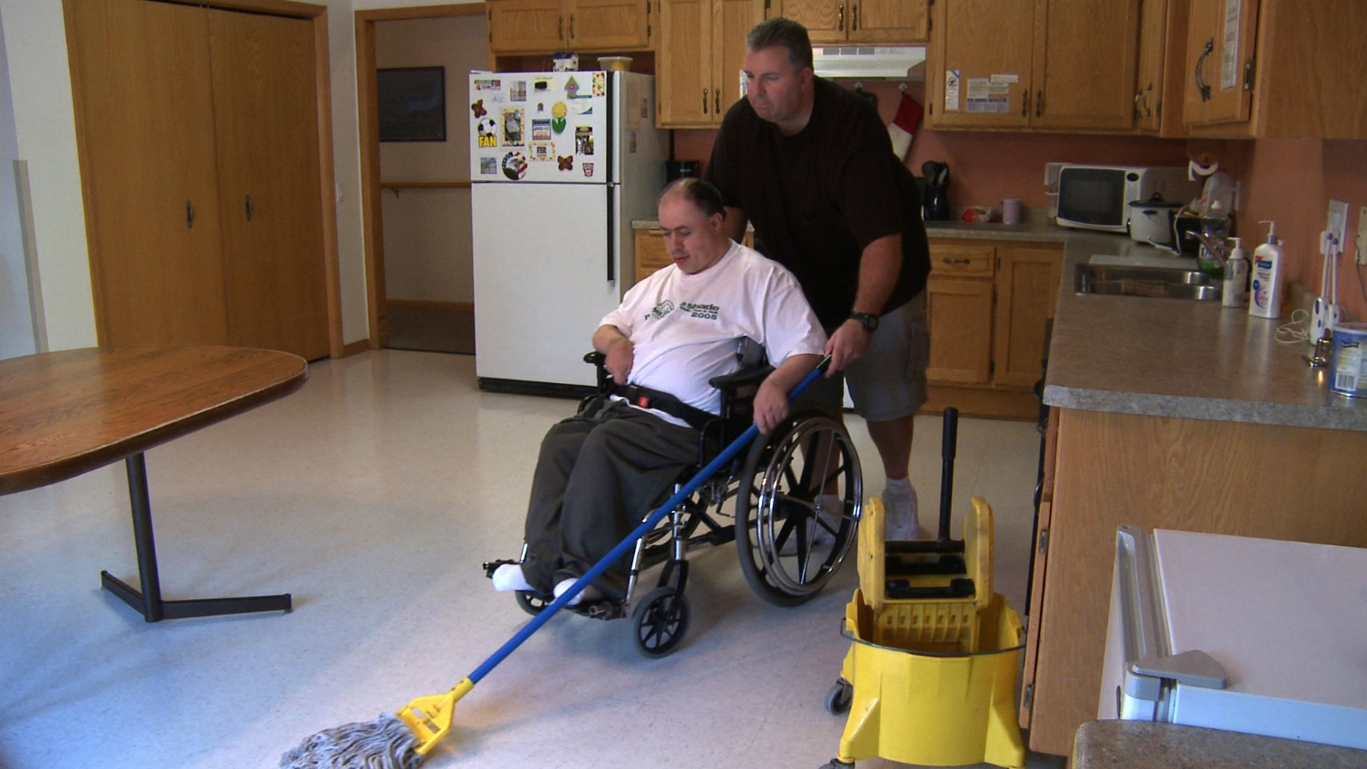
Research and Training Center on Community Living, Institute on Community Integration UNIVERSITY OF MINNESOTA
Active Support Intervention and its Potential Effect on Increased Engagement of Persons with Intellectual and Developmental Disabilities
Mark Olson and Renáta Tichá
What is Active Support?
ACTIVE SUPPORT BASELINE OBSERVATION STUDY
Results
A direct support staff (DSP) training and organizational approach originally developed in the UK and Australia designed to increases the capacity of DSPs to plan for and to engage people with disabilities in skill development, meaningful daily activities, and increased opportunities for choice and decision making regardless of their support needs.
Participants
Observed Levels of Engagement
Individuals with intellectual and developmental disability (IDD) (n=78)
Average age = 41 years old
53% were male
23% had mild, 26% moderate, 17% severe, and 35% profound IDD
56% used speech for communication, and the rest used AAC
Staff (n=121)
18% had high school diploma and 18% had a college degree
Supervisors (n=20)
Research Question
Observed Levels of Engagement and Staff Assistance by Level of IDD
Active Support Cycle
(1) What proportion of the time are individuals with IDD in group homes engaged in meaningful activities?
(2) To what extent do individual characteristics, staff behaviors, and house/organizational factors predict overall engagement level?
“Every Moment Has Potential To Engage People in Meaningful Activity” – but without careful planning and preparation, these moments are often lost.
1. Plan & Prepare:
A. Learn about People’s:
i. Routines
ii. Expectations
iii. Preferences
iv. Interests
B. Develop your system:
i. Sharing ideas
ii. Maintaining agreements
iii. Developing approaches
C. Prepare the environment:
i. Right time
ii. Right tools
iii. Right way
Measures of Engagement
“Maximizing Choice and Control” for the person during support is an important measure of quality because it gives people opportunities and increases their comfort.
Two types of engagement were coded using direct observations:
Social Engagement consists of recognizable speech or attempts to speak signs, gestures or other attempts to gain or retain the attention of another person (e.g., talk about a movie)
Nonsocial engagement consists of nonsocial activities such as participation in leisure activities, domestic activities or personal care.
Staff assistance consists of explicit and implicit instruction related to a task, gestural prompts, demonstration, physical prompting or guidance.
Each individual with IDD was observed in 10-minute intervals for 80 minutes in total at baseline. Real time continuous observational data were collected using the Multi-Option Observation System for Experimental Studies (MOOSES, Tapp, Wehby & Ellis, 1995).
2. Try/Do
A. With each person supported
B. Every day
C. Some planned/some spontaneous
D. Accept the challenge
E. Make it enjoyable
F. Communicate
G. Cooperate with teammates
Discussion and Implication
The levels of engagement were consistent with what was reported in previous literature in the U.K. and Australia.
Staff assistance in the current study was less compared to the data reported in previous research (Stancliffe et al., 2007).
Participants with profound IDD were much less engaged compared to residents who have mild intellectual disabilities.
People with IDD whose behavior enables them to live more independently are more likely to be engaged in their life while living in community group homes.
Younger people with IDD tend to be more socially engaged.
Culture of the group home makes a difference in people’s nonsocial and social engagement.
People with IDD who have more competent staff tend to be more socially engaged.
Active Support training has the potential to increase and improve staff assistance to individuals with IDD, and thus increase engagement of individuals IDD, especially those with severe and profound disabilities.
3. Review, Evaluate, and Share:
A. Learn from what happens
B. Share what you learned.
C. Keep the system fresh
D. Keep opportunities fresh
E. Think about it
“Little and Often” keeps people interested and doesn’t overwhelm.
“Graded Assistance To Ensure Success” is enough support, at the right time, in the right way, so that people want to participate.
Active Support Techniques and Approaches
task analysis (used for protocols)
partial participation
graded assistance
observable, measurable goals and outcomes
positive reinforcement
Project Team
Training: Susan O’Nell , Mark Olson, John Sour, Amy Hewitt
Evaluation: Sheryl Larson, Renaáa Tichá, Xueqin Qian, Roger Stancliffe
Technical Support: Jerry Smith, and John Westerman
This research was supported in part by a grant from the National Institute on Disabilities and Rehabilitation Research, U.S. Department of Education (Agreement No. H133B080005-09) to the University of Minnesota’s Research and Training Center on Community Living with supplemental support from the Administration on Developmental Disabilities (Grant No. 90D0217/01) of the U.S. Department of Health and Human Services and a Cooperative Agreement.
Contact Information
Sheryl Larson, larso072@umn.edu
Renáta Tichá, tich0018@umn.edu
Mark Olson, olso4541@umn.edu

